Slide 1

Final Project: ADTA 5550 Deep Learning with Big Data
Mudita Garg
MS in Business Analytics, College of Business, UNT

Slide 2
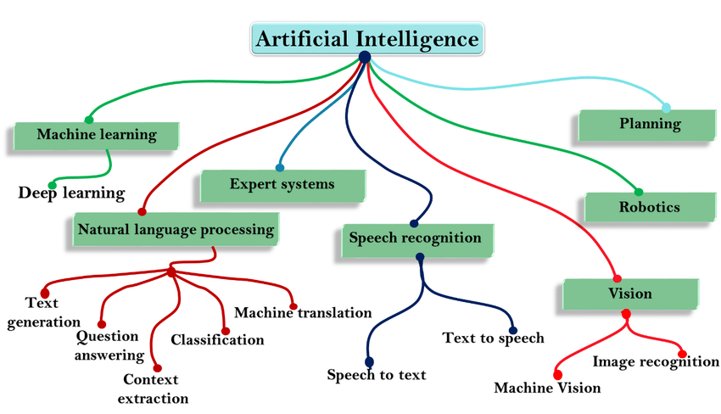

Slide 3
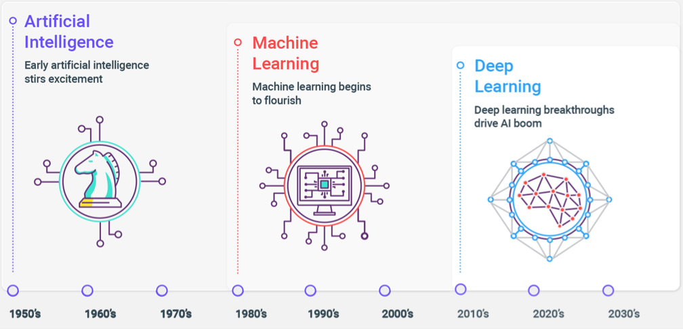
Evolution of Artificial Intelligence

Slide 4
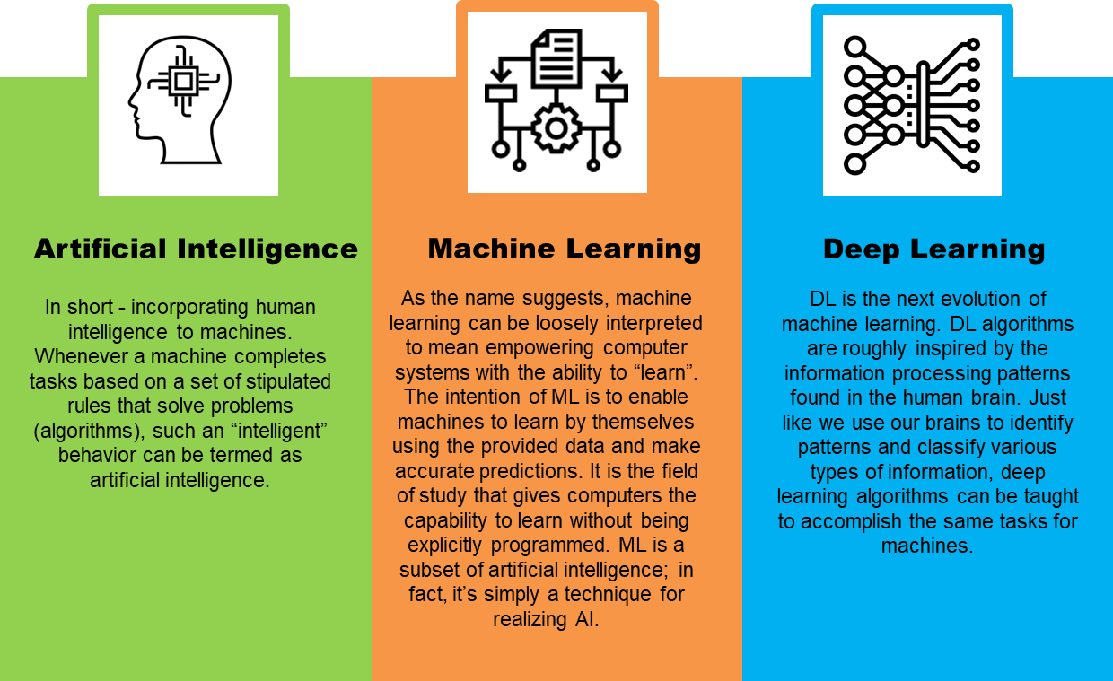
Difference between AI and its subsets

Slide 5
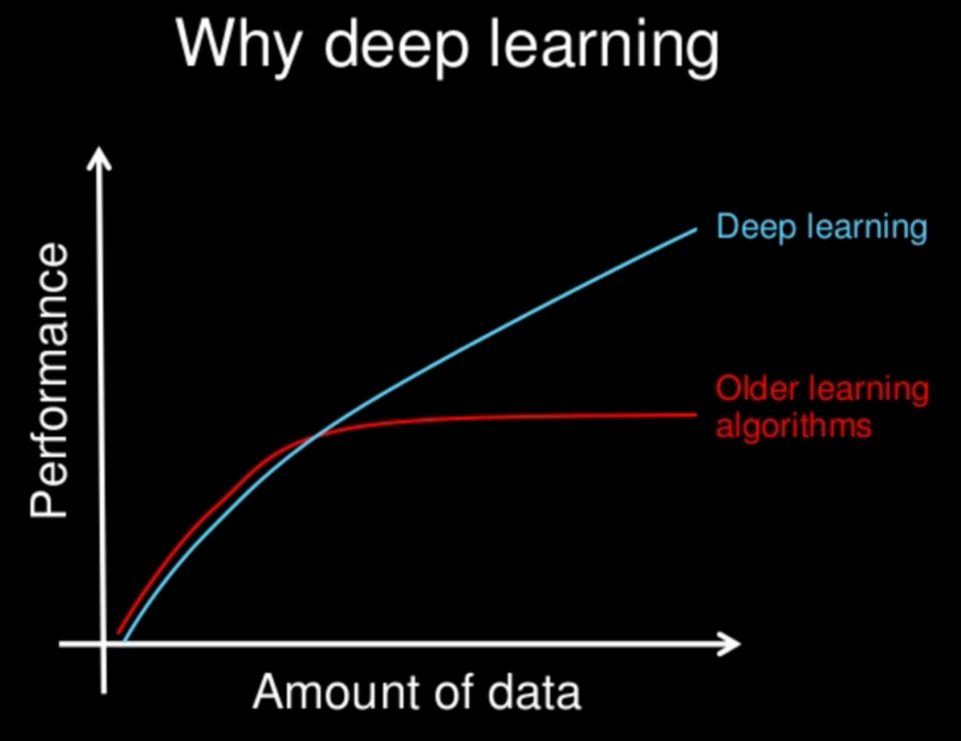
Why Deep Learning is so popular these days?
Deep Learning system engineers its own features as much as is feasible.
Creates large-scale neural nets that allow the computer to learn and “think” by itself without the need for direct human intervention.
Supremacy in accuracy when trained with huge amount of data.

Slide 6
Deep Learning Architecture
Deep Learning (Neural Network)
Supervised
Convolutional Neural Network
Recurrent Neural Network
Unsupervised
Self Organizing Maps
Autoencoders
Restricted Boltzman Machines
Long Short-Term Memory
Gated Recurrent Unit

Slide 7
How Deep Learning Works?
Main motive : simulate human-like decision making.
Neurons in the brain pass the signals to perform the actions. Similarly, artificial neurons connect in a neural network to perform tasks clustering, classification, or regression.
The neural network sorts the unlabeled data according to the similarities of the data.
Neurons are grouped into three different types of layers:
Input layer : Receives input from the observations
Hidden layer : Nonlinear processing for feature extraction and transformation
Output layer: Desired result

Slide 8
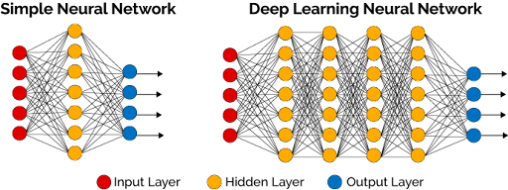
Architecture of a Neural Network

Slide 9
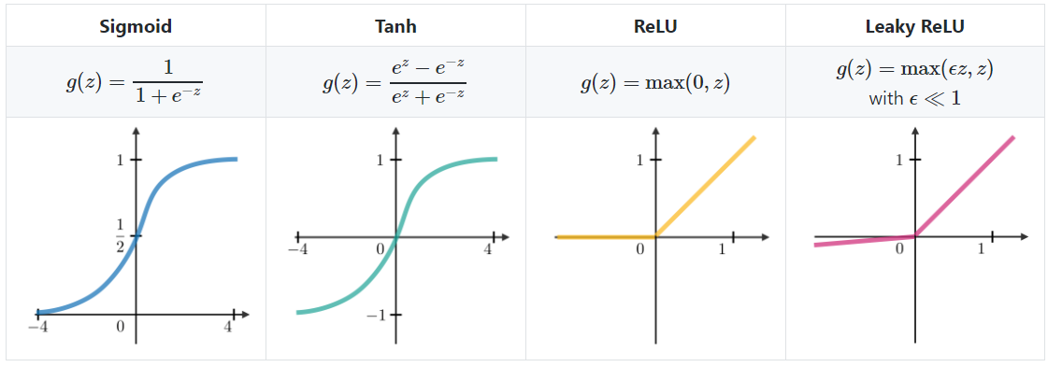
Common Activation Functions

Slide 10
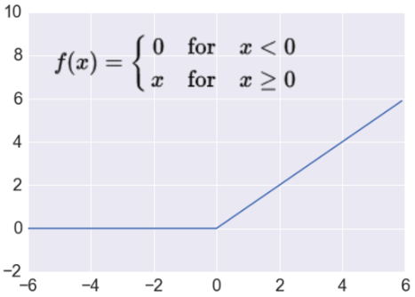
Activation: ReLU
Trains much faster
accelerates the convergence of SGD
due to linear, non-saturating form
Less expensive operations
compared to sigmoid/tanh (exponentials etc.)
implemented by simply thresholding a matrix at zero
More expressive
Prevents the gradient vanishing problem.
Notes:
Most Deep Networks use ReLU nowadays.

Slide 11
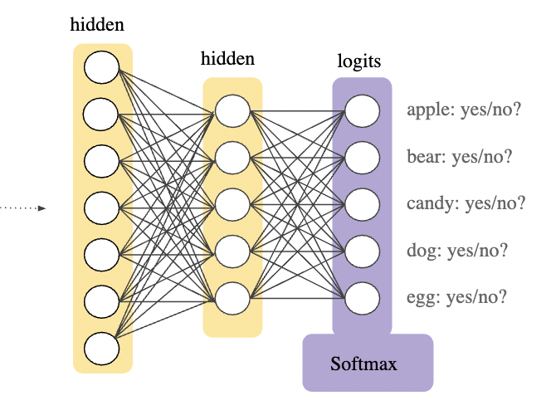
SoftMax function
Often used as the final layer in multi-class classification neural networks.
The function squeezes the outputs for each class between 0 and 1 , then divides by the sum of the outputs and gives the probability that an output is in a particular class.

Slide 12
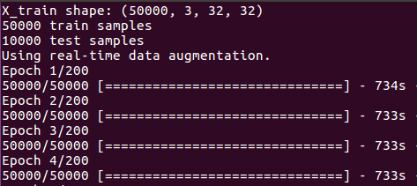
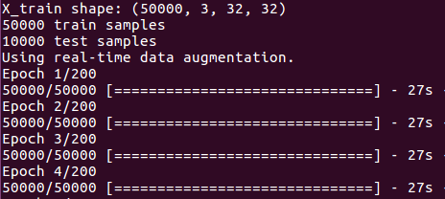
Why GPU matters in Deep Learning?
GPUs are optimized for training artificial intelligence and deep learning models as they can process multiple computations simultaneously.
GPUs boost the performance in parallel computation.
Running time without GPU
Running time with GPU
With GPU, the running time is 27.1 times faster then without GPU.

Slide 13

Easy Model Building: TensorFlow offers multiple levels of abstraction to build and train models.
Robust ML Production Anywhere: TensorFlow lets you train and deploy your model easily, no matter what language or platform you use.
Powerful Experimentation For Research: TensorFlow gives you flexibility and control with features like the Keras Functional API and Model Subclassing API for the creation of complex topologies.

Slide 14

Keras is a high-level neural networks library that is running on top of the TensorFlow, CNTK and Theano.
It allows easy and fast prototyping with seamless running on CPU and GPU.
User-Friendly: Keras has a simple, consistent interface optimized for common use cases which provides clear and actionable feedback for user errors.
Modular and Composable: Keras models are made by connecting configurable building blocks together, with few restrictions.
Easy To Extend: With the help of Keras, you can easily write custom building blocks for new ideas and researches.
Easy To Use: Keras offers consistent & simple APIs which helps in minimizing the number of user actions required for common use cases, also it provides clear and actionable feedback upon user error.

Slide 15

Convolution Neural Networks
Image pixel intensity are the inputs into a CNN – use three channels for color images (RGB)
• In the convolutional layer, each neuron is only connected to a subset of input neurons that correspond to pixels located next to each other (local receptive field)
• Vertical and horizontal filters are applied to make neurons react only to certain orientation of lines (edges) – this creates different feature maps that capture different features
• Pooling layers sub-sample the inputs effectively shrinking the image to reduce computational load.

Slide 16
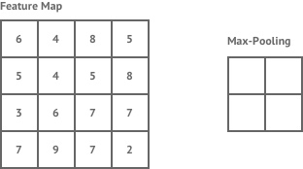
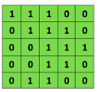

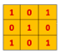
CNNs
An image is a rectangle of length * height pixels. If an image is black and white, each pixel is represented by one number, intensity. Therefore, we need one channel.
Main CNN idea for text:
Compute vectors for n-grams and group them afterwards
Example: “this takes too long” compute vectors for:
This takes, takes too, too long, this takes too, takes too long, this takes too long.
Convolutional
3x3 filter
Input matrix

Slide 17


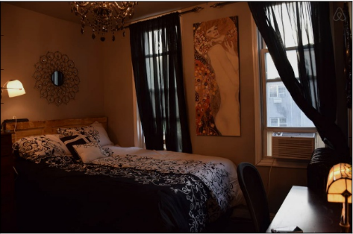
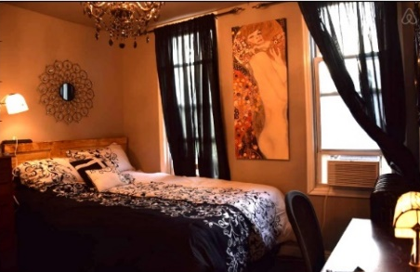
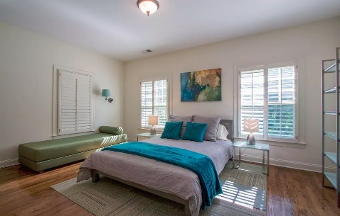

Optimizing Images
Post Processing Feature Optimization (Color Curves and Details)
Post Processing Feature Optimization (Illumination)
Post Processing Feature Optimization (Color Tone: Warmness)

Slide 18

When to use Deep Learning or not over others?
Deep Learning outperforms other techniques if the data size is large. But with small data size, traditional Machine Learning algorithms are preferable.
Deep Learning techniques need to have high end infrastructure to train in reasonable time.
When there is lack of domain understanding for feature introspection, Deep Learning techniques outshines others as you have to worry less about feature engineering.
Deep Learning really shines when it comes to complex problems such as image classification, natural language processing, and speech recognition.

Slide 19

Classification Example – MNIST
The MNIST database of handwritten digits, has a training set of 60,000 examples, and a test set of 10,000 examples.
It is a subset of a larger set available from NIST.
The digits have been size-normalized and centered in a fixed-size image.

Slide 20
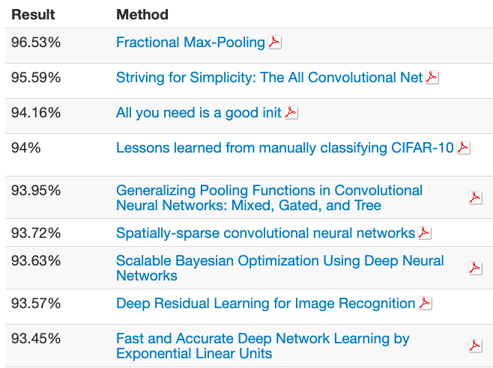
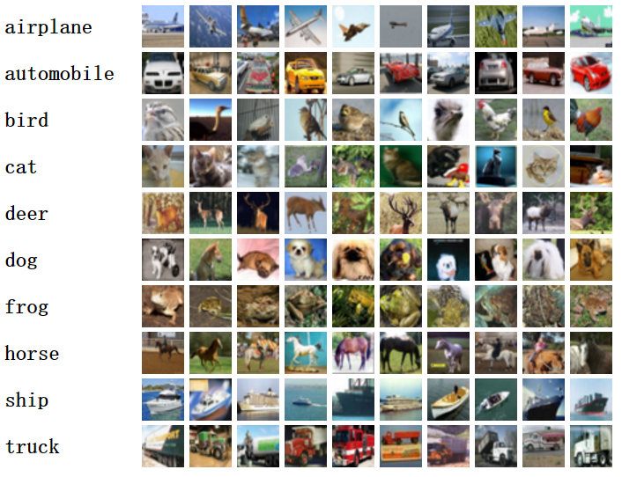
About the CIFAR10 dataset
The CIFAR-10 dataset consists of 60000 32x32 color images in 10 classes, with 6000 images per class.
The dataset is divided into five training batches each with 10000 images and one test batch.
There are 50000 training images and 10000 test images.
Here are the classes in the dataset as mentioned below:

Slide 21

Objective of the project
Deal with a classification problem
To build, train and test a classification model using TensorFlow that can classify images

Slide 22
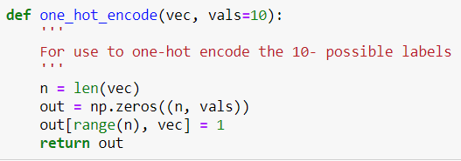
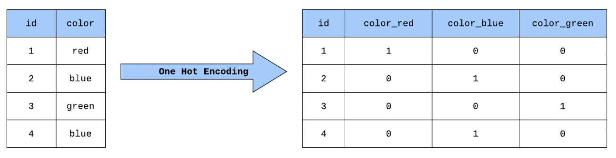
One-hot encoding
Creates a new binary feature for each possible category and assigns a value of 1 to the feature of each sample that corresponds to its original category
One-hot encoding is performed on class labels.
Since class labels were already integer-coded, hence one-hot coding was applied by defining a function

Slide 23
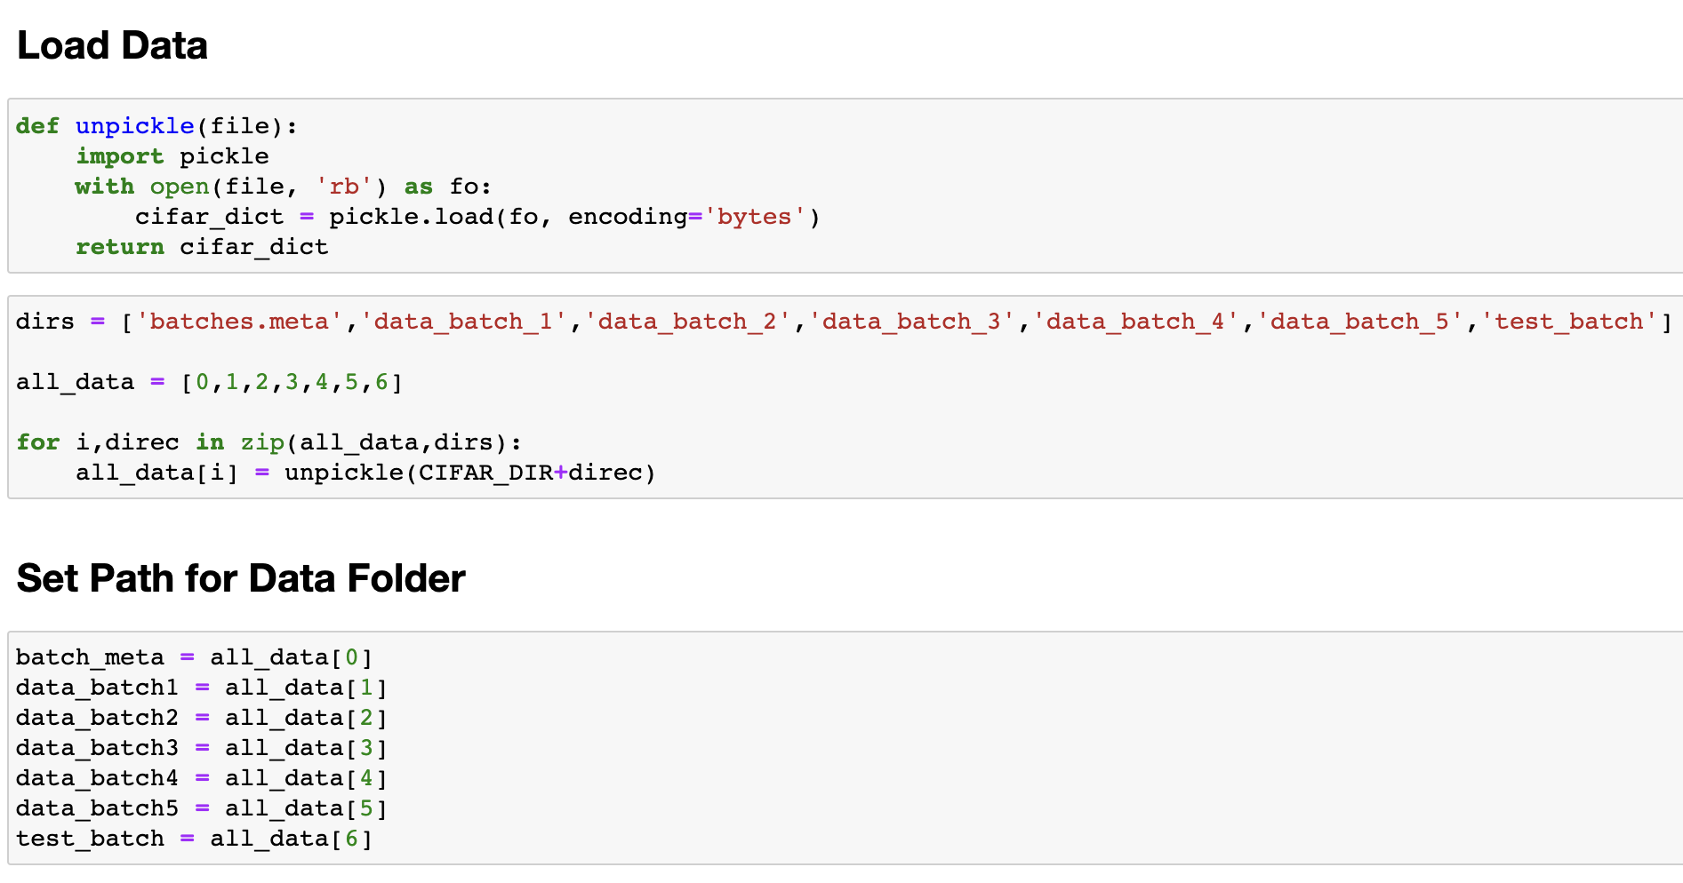
Data Pre-Processing
The data file containing the data is pickled
Pickling converts python object into stream of characters
To perform data exploration, we unpickle the files using by defining an unpickle function

Slide 24
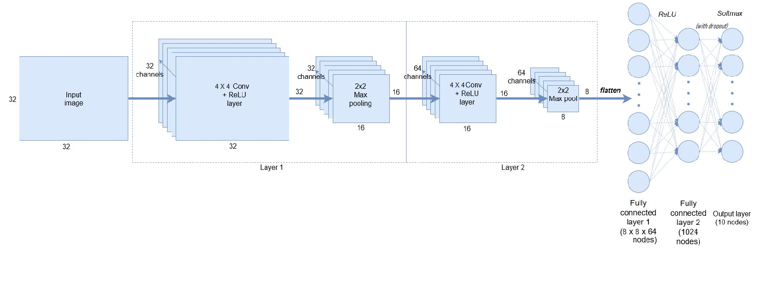
Building CNN Model
A CNN model works in three stages.
First stage, a convolutional layer extracts the features of the image/data.
Second stage a pooling layer reduces the dimensionality of the image, so small changes do not create a big change on the model. Simply saying, it prevents over-fitting.
Third stage a flattening layer transforms the model in one-dimension and feeds it to the fully connected dense layer. This dense layer then performs prediction of image

Slide 25
Parameters for CIFAR-10 CNN model
The amount that the weights are updated during training is referred to as the step size or the “learning rate.”
The batch size is a hyperparameter that defines the number of samples to work through before updating the internal model parameters.
Epochs is a hyperparameter that defines the number times that the learning algorithm will work through the entire training dataset.
Parameters | CIFAR-10
Learning_rate batch_size Training Steps Number of Convolution Layers | 0.001 100 5000 2
Final Accuracy_of the test set | 62.23%

Slide 26
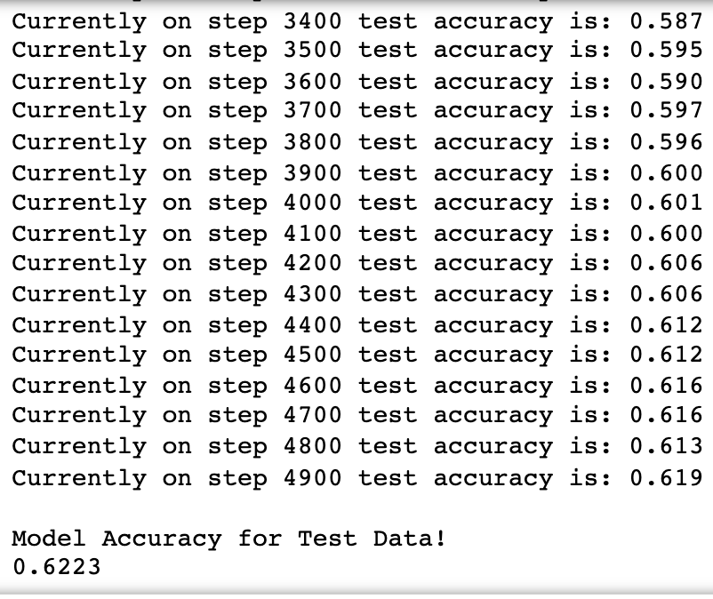
Results & Conclusion
The training steps are 5000.
Network was tested after every 100 steps of training.
Accuracy reached about 60% at step 3900.
The result of the testing shows 62.23% of test accuracy. The model appears to have average accuracy. It can be further improved.
Hyper parameters defined in the model determine the optimization behavior (learning rate, batch size, etc.).
The accuracy is not very high. The model can be redesigned or hyperparameters can be changed using trial and error to check for increased accuracy

Slide 27
Comparison of MNIST and CIFAR-10 Accuracy
The accuracy of the model MNIST is about 98.49% with 5000 training steps and one epoch but for the CIFAR-10 it is 62.23%
The accuracy of MNIST data reached to 90.27% in step 500 and gradually increased to 98.49%. However, for CIFAR-10 data the test accuracy reached 61.33% in step 1000 and gradually increased to 62.13% in the step 4300.

Slide 28
Gap in performance amongst both models
This gap in the accuracies could be due to various reasons.
The CNN model works differently with different datasets even if we set the same parameters and layers which is sometimes called stochastic nature of the algorithm.
While training the model, the learning capability of the model depends on the batch size, learning rate, epochs, convolution layers, etc.
MNIST data was normalized which was not the case with CIFAR-10.

Slide 29
Improving the CIFAR-10 model
There are two cases that were designed to improve the accuracy of the CIFAR-10 dataset.
Accuracy improved from (62.23%) to approximately 68% in both the cases. Case 1 took lesser time to execute than case 2 due to lesser number of training steps.
Due to similar accuracy that was gained from case 1 and case 2, I will prefer case 1 since it takes lesser time to execute and still gives great accuracy. This model got about 10% of the accuracy gain.
 | Case 1 | Case 2 | Case 3
Learning_rate batch_size training_step Number of Convolution Layers | 0.0001 100 10000 2 | 0.0001 100 15000 2 | 0.001 100 5000 2
Accuracy_Evaluation | 67.73% | 69.62% | 69.60%

Slide 30
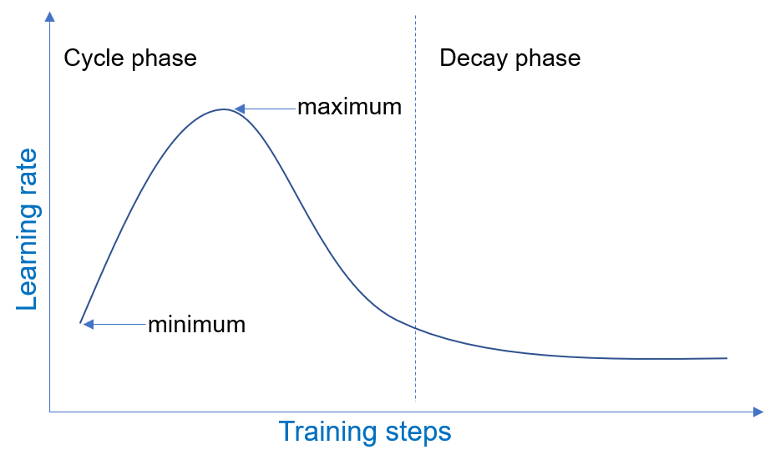
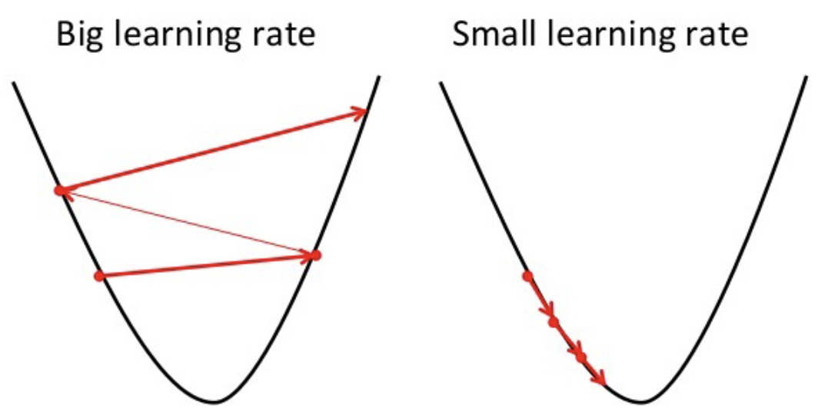
Effect of Learning Rate
The learning rate hyperparameter controls the rate or speed at which the model learns.
The model will learn to best approximate the function given available resources (the number of layers and the number of nodes per layer with number of training epochs (passes through the training data).
A large learning rate allows the model to learn faster, at the cost of arriving on a sub-optimal final set of weights.
A smaller learning rate may allow the model to learn a more optimal or even globally optimal set of weights but may take significantly longer to train.

Slide 31
Conclusion
In this project, first, a successful CNN model with an accuracy of 62.16% was created to classify images of the CIFAR-10 data set.
The model was then compared to the MNIST CNN model with similar training steps and 2- convolutional layers yet there was a high gap in accuracy as both the datasets are different, hence similar models provided different results
Fine-tuning the parameters can improve the accuracy of the model to some extent. After increasing the number of steps and learning rate, the accuracy of the CNN model was improved to 69.60% making 10% increase.

